Slide 1
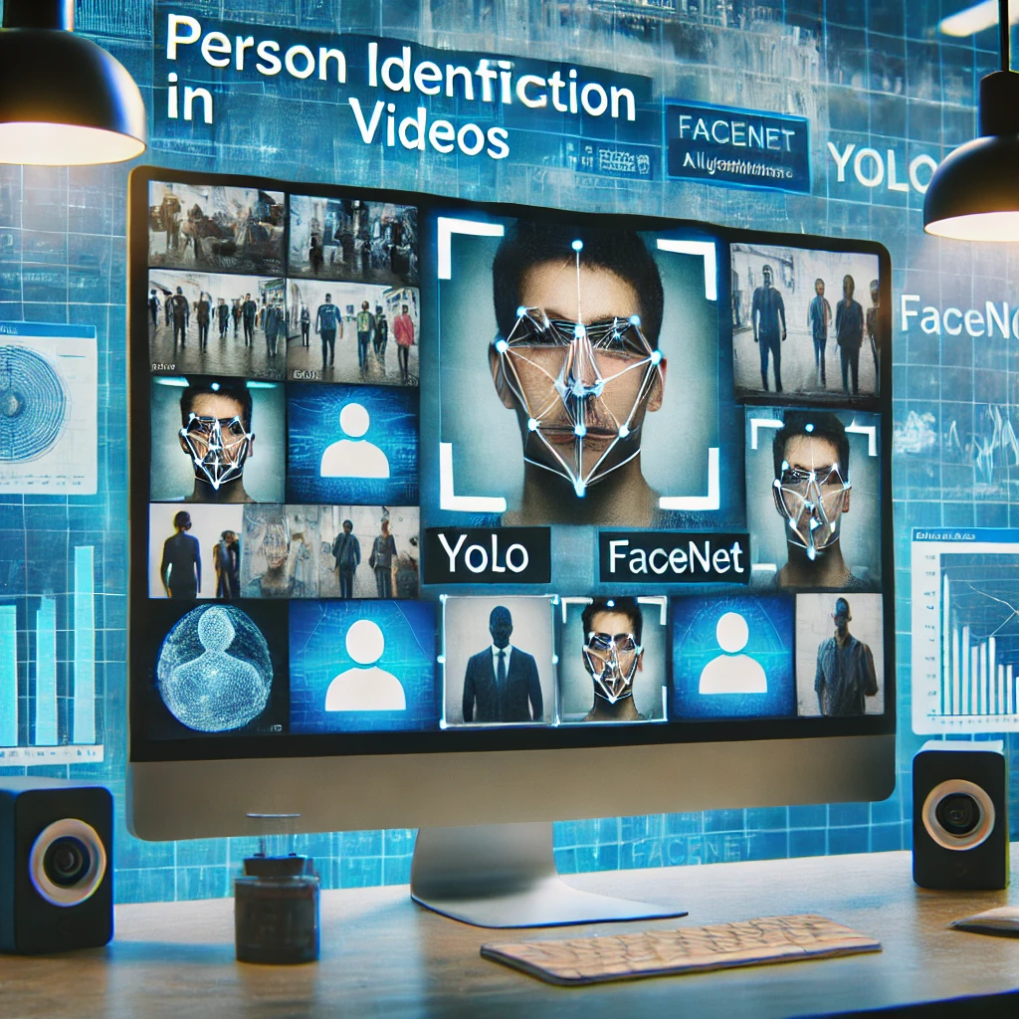


AI-Driven Person Recognition and Identification in Videos
Capstone Project Phase A
Rom Harel
Itai Benjamin
Supervizor: Mr. Ilya Zeldner
With help of : Dr. Naomi Unkelos-Shpigel Project code: 24-1-D-35
01

Slide 2
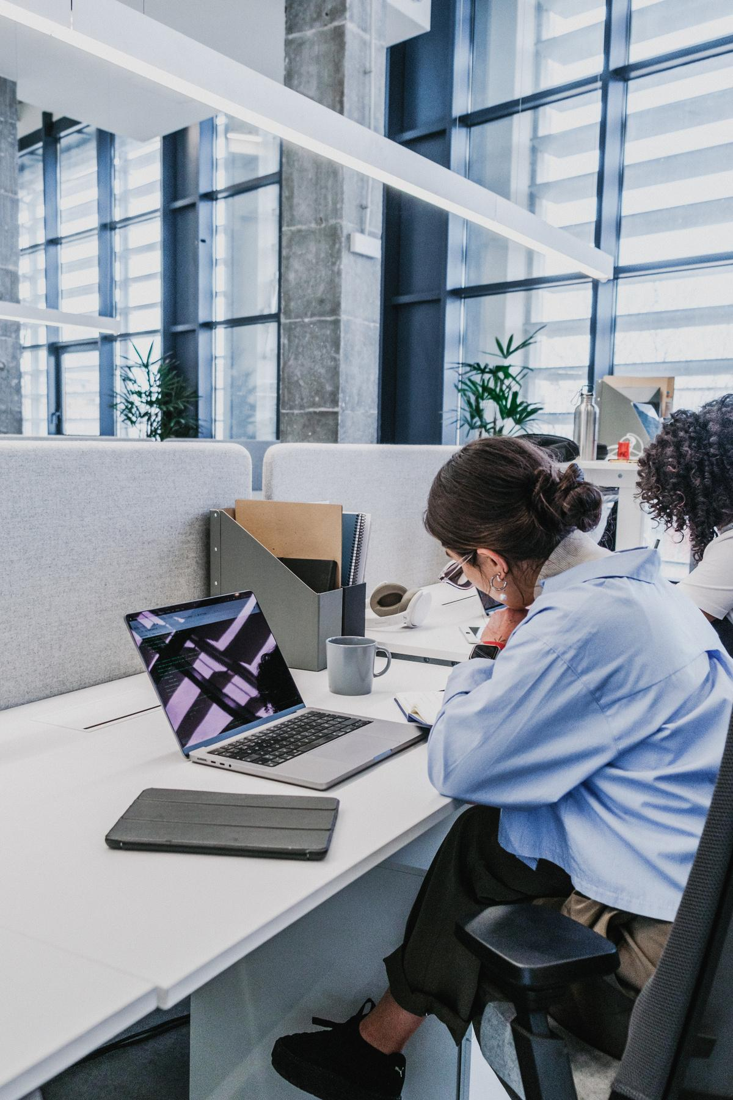

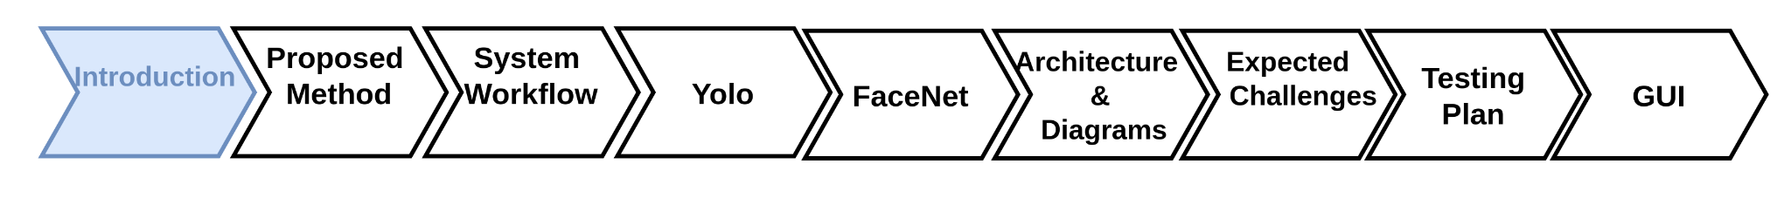
Overview
Introduction
03
Proposed Solution
04
System Workflow
05
Yolo
06-09
FaceNet
10-11
Architecture & Diagrams
12-14
Expected Challenges
15
Evaluation Plan
16
GUI
17-19
02

Slide 3
Introduction
High demand for accurate person identification in videos.
Increased Need Post-October 7
No free, user-friendly video analysis system available.
03
Notes:
אם זה הצגת הבעיה, צריך לשכנע יותר. מדוע מה שיש כרגע לא מספיק? מה יש כרגע? הבעיה של חיפוש דמויות ספציפית בוידאו אנחנו מכירים את זה שעושים את זה במכה אחת , אנחנו רוצים לחדד את הזיהוי

Slide 4
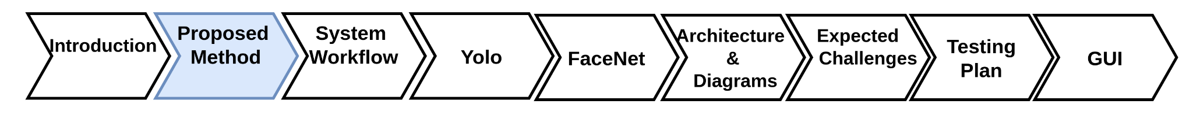
Proposed Solution
Object Detection
Using YOLO Model
Facial Recognition
Using FaceNet Model
Integrate YOLO and FaceNet
User-Friendly Interface
04
Notes:
Reference : Yolo : Redmon, J., Divvala, S., Girshick, R., & Farhadi, A. (2016). You only look once: Unified, real-time object detection. In Proceedings of the IEEE conference on computer vision and pattern recognition (pp. 779-788).‏ FaceNet : Schroff, F., Kalenichenko, D., & Philbin, J. (2015). Facenet: A unified embedding for face recognition and clustering. In Proceedings of the IEEE conference on computer vision and pattern recognition (pp. 815-823).‏‏

Slide 5
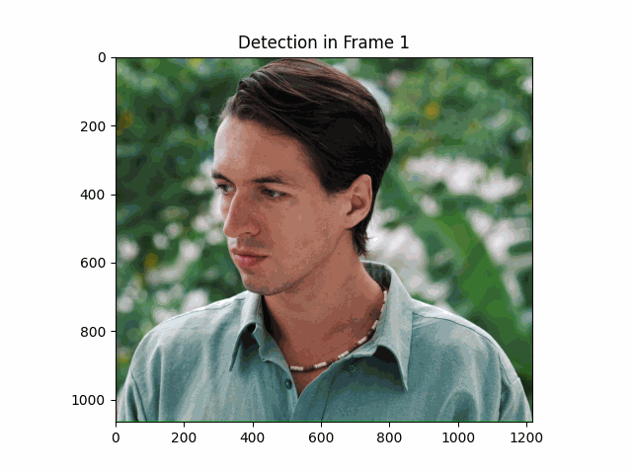
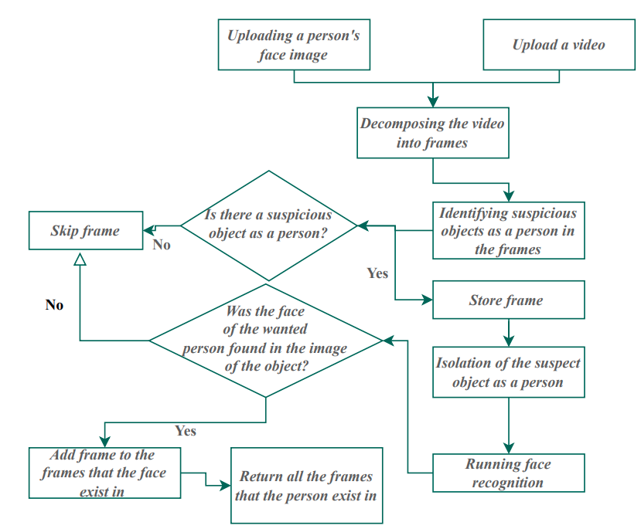

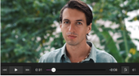
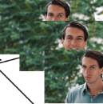
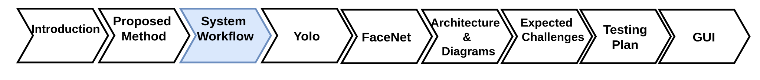
Architecture
Yolo
System
Workflow
FaceNet
05

Slide 6
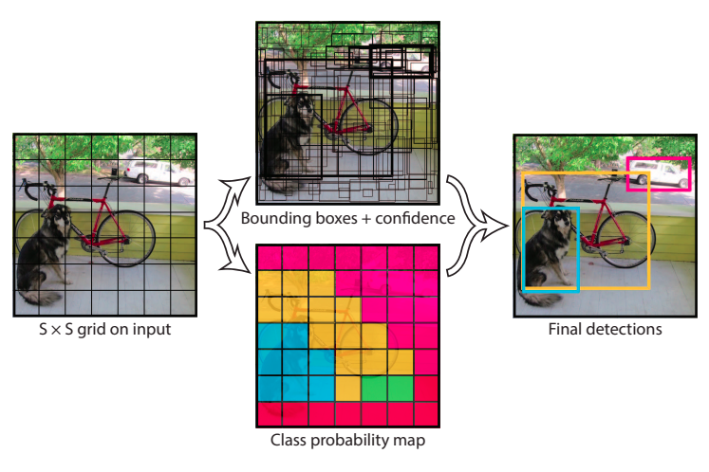

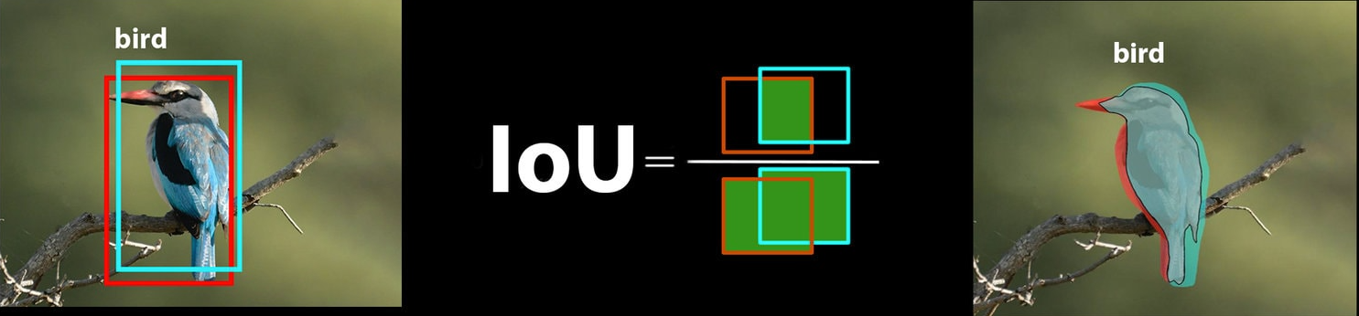
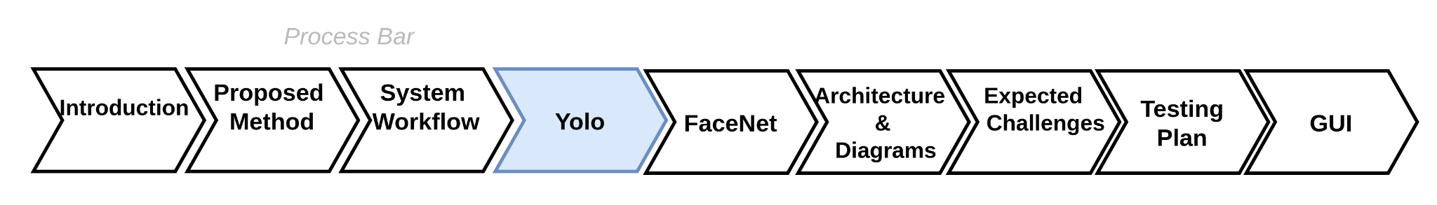
Yolo
You Only Look Once Real-time object detection system
Single convolutional neural network
Divides the input image into a grid system
Each cell in the grid is responsible for detecting objects within itself
Predicts bounding boxes and class probabilities
Non-Maximum Suppression.
06
Notes:
Reference : Redmon, J., Divvala, S., Girshick, R., & Farhadi, A. (2016). You only look once: Unified, real-time object detection. In Proceedings of the IEEE conference on computer vision and pattern recognition (pp. 779-788).‏
Ultralytics YOLO Docs : https://docs.ultralytics.com/models/yolov8/

Slide 7
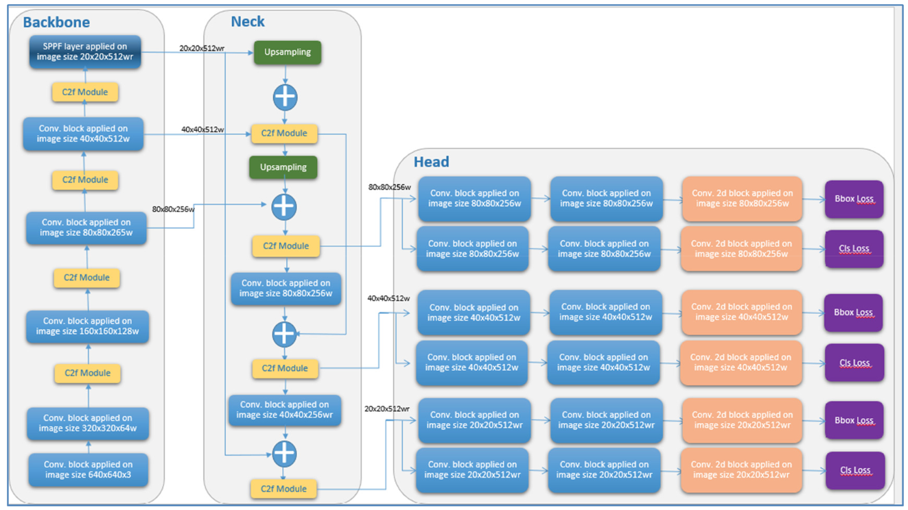
Yolo V8 Architecture
As we go Deeper
Image Size
Feature Maps
Different Scales
07
Notes:
Figure Referance :
Ahmed, R., & Abd-Elkawy, E. H. (2024). Improved Tomato Disease Detection with YOLOv5 and YOLOv8. Engineering, Technology & Applied Science Research, 14(3), 13922-13928.‏

Slide 8
Yolo V8 Architecture
FPN
Combine Features From Different Levels
07
Notes:
Figure Referance :
Ahmed, R., & Abd-Elkawy, E. H. (2024). Improved Tomato Disease Detection with YOLOv5 and YOLOv8. Engineering, Technology & Applied Science Research, 14(3), 13922-13928.‏

Slide 9
Yolo V8 Architecture
07
Notes:
Figure Referance :
Ahmed, R., & Abd-Elkawy, E. H. (2024). Improved Tomato Disease Detection with YOLOv5 and YOLOv8. Engineering, Technology & Applied Science Research, 14(3), 13922-13928.‏

Slide 10
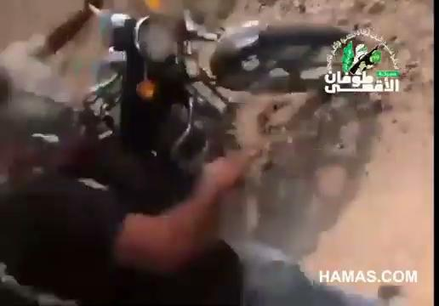
Yolo Prediction Example
08

Slide 11
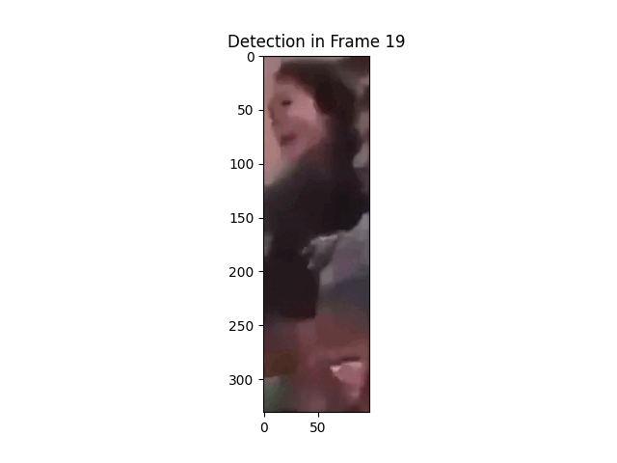

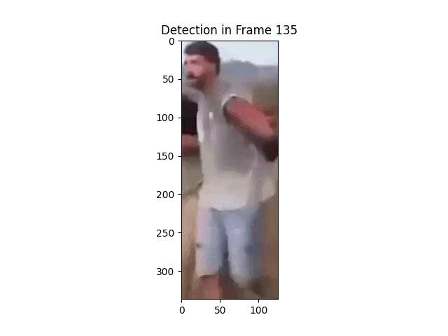
Our uses with YOLO
01
Detecting
02
Locating
03
Isolating
09

Slide 12
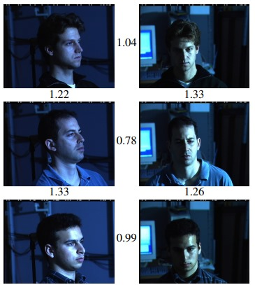
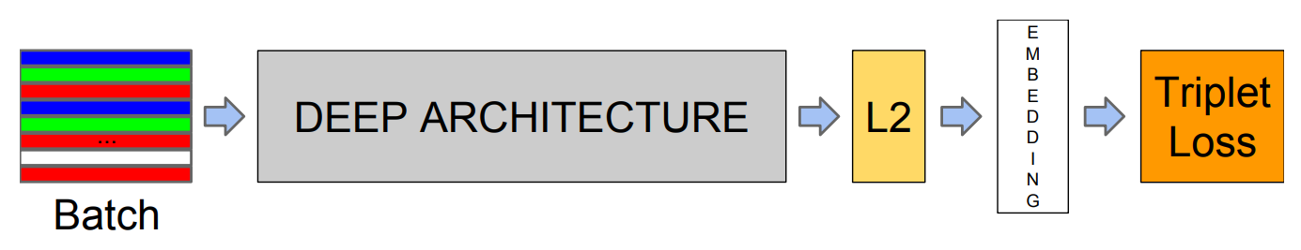
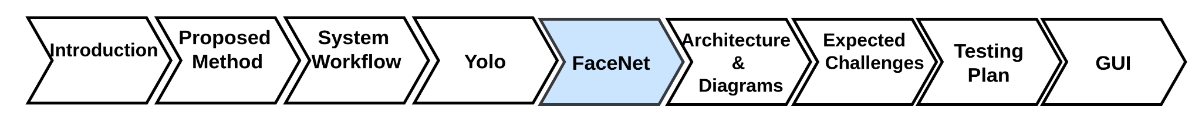
FaceNet
Facial recognition Model
Developed by Google (2015).
Transforms facial images into a Euclidean space.
Uses deep CNN for feature extraction, embedding layer for fixed-size vector representation, and triplet loss for optimized face similarity.
Effective against variations in pose, lighting, and expression.
10
Notes:
Schroff, F., Kalenichenko, D., & Philbin, J. (2015). Facenet: A unified embedding for face recognition and clustering. In Proceedings of the IEEE conference on computer vision and pattern recognition (pp. 815-823).‏‏

Slide 13
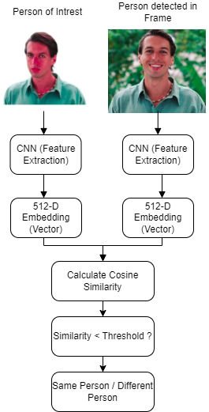
Person of
Interest
Person Detected
in frame
Our uses with FaceNet
Identifying the presence of specific individuals within video frames.
Comparing detected faces to the provided image for verification.
Marking and returning frames containing the identified individual.
11
Notes:
Schroff, F., Kalenichenko, D., & Philbin, J. (2015). Facenet: A unified embedding for face recognition and clustering. In Proceedings of the IEEE conference on computer vision and pattern recognition (pp. 815-823).‏‏

Slide 14
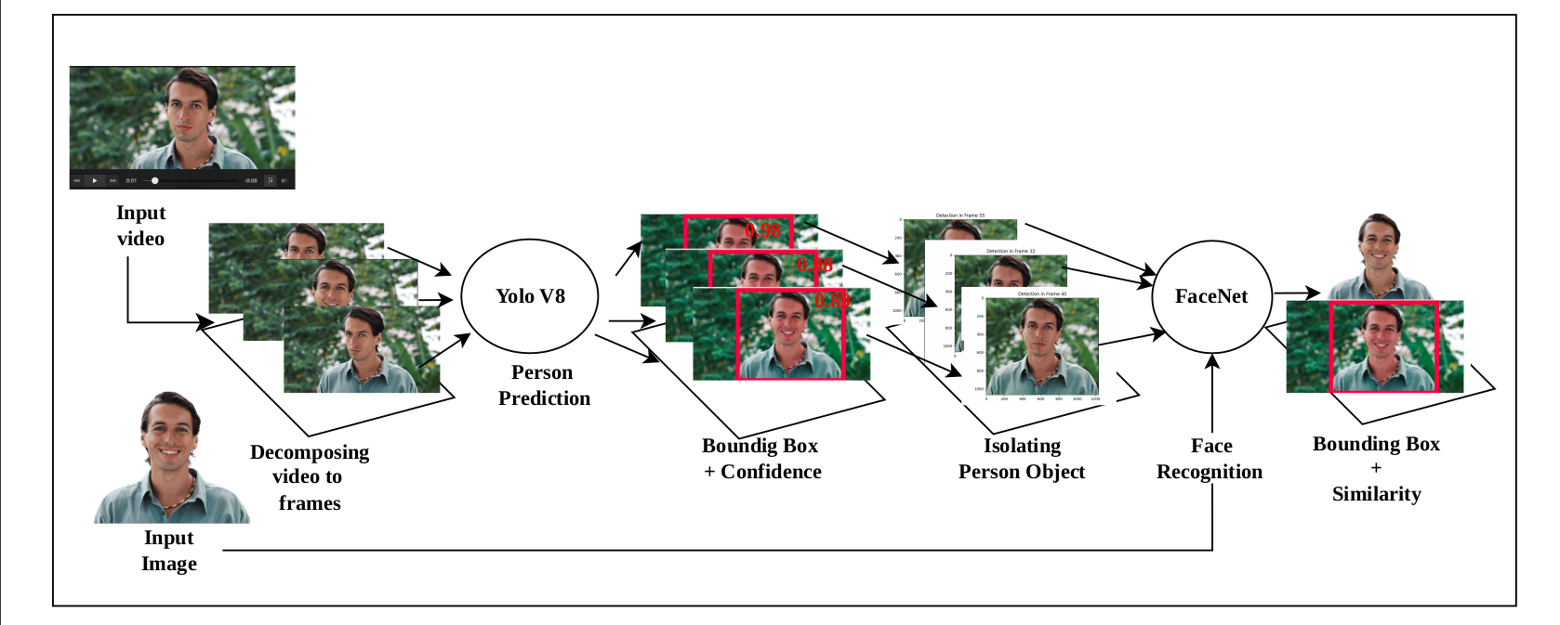
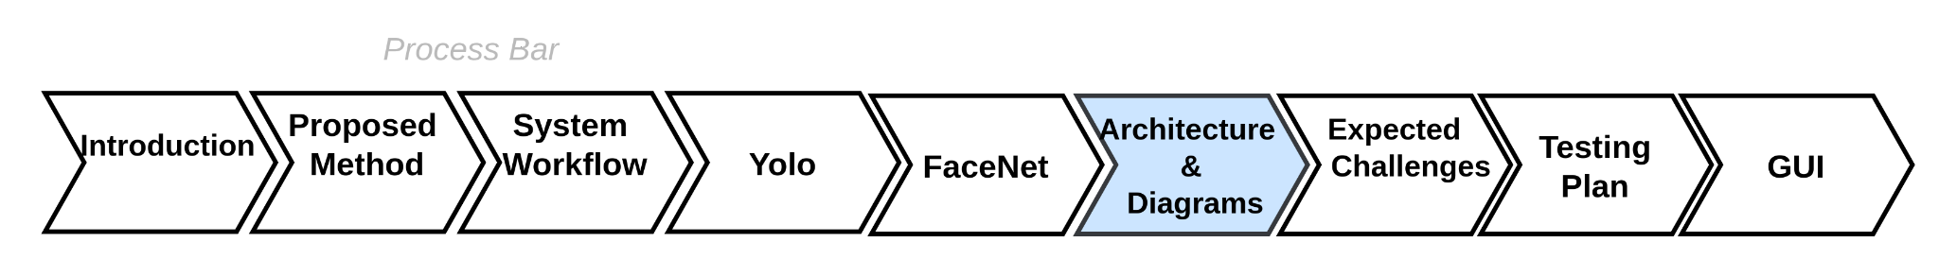
Architecture
Yolo
FaceNet
Result
Result
Algorithm
Algorithm
12
Notes:
כמו שאתם זוכרים , דיברנו ארכיטקטורה ועכשיו נכנס עמוק יותר

Slide 15
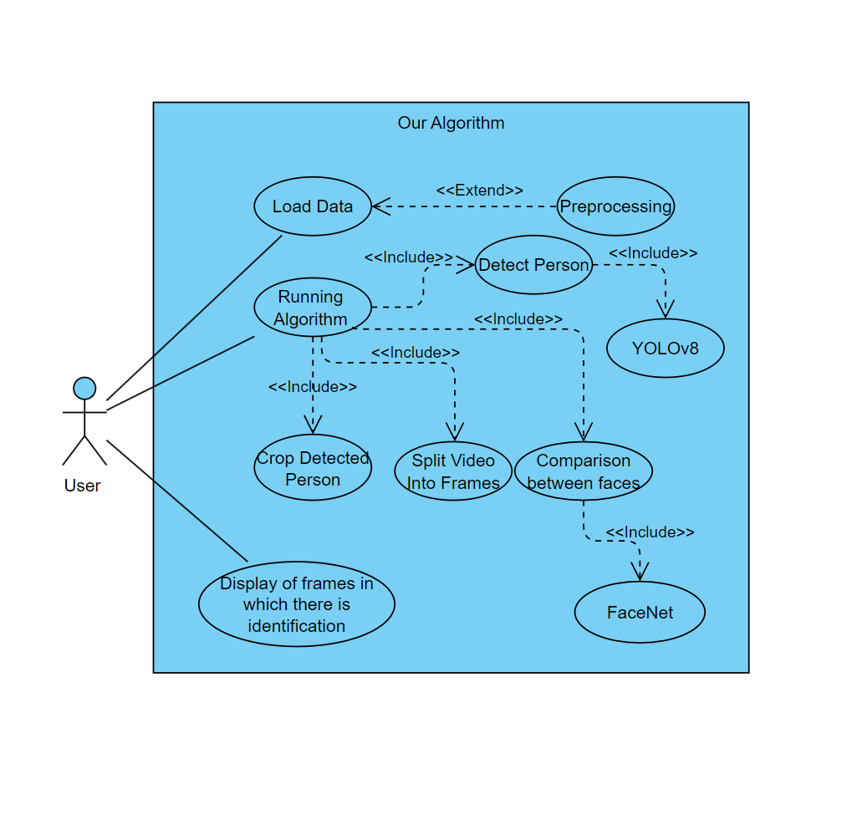
Use Case
Diagram
13

Slide 16
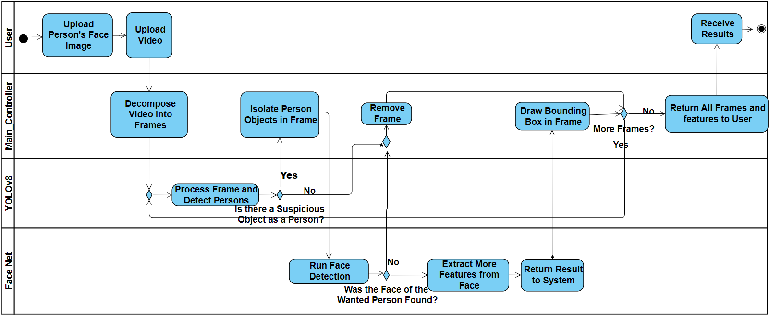
Activity Diagram
14

Slide 17
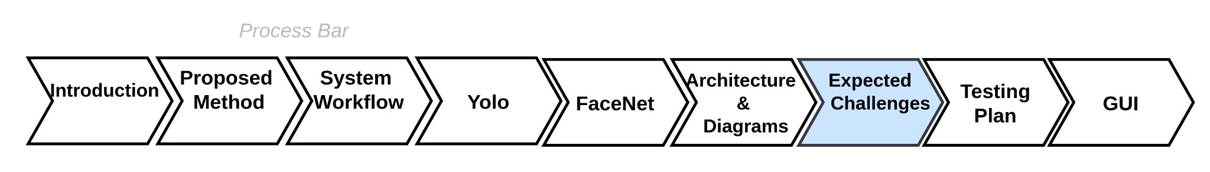
01
Managing occlusions and partial visibility
Expected Challenges
Achieving real time performance
02
03
Cross domain generalization
15
Notes:
במקומו לשים תוצאות עם גרפים תוצאות מקרים השוואות

Slide 18
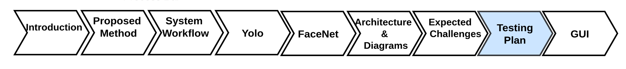
Evaluation Plan
Test Description | Expected results
Test YOLO accuracy of person detection | High accuracy and recall measure in person detection
Test FaceNet accuracy of facial recognition | High accuracy and recall in measure in facial recognition
Test with video showing person at different angles | System performs detection and recognition accurately
Validate overall system functionality | System meets user expectations and needs
16
Notes:
תוצאות הטסטים כל טסט שהצגנו פה נחליף בטסט אמיתי עם תוצאה לבחור 3 גג

Slide 19
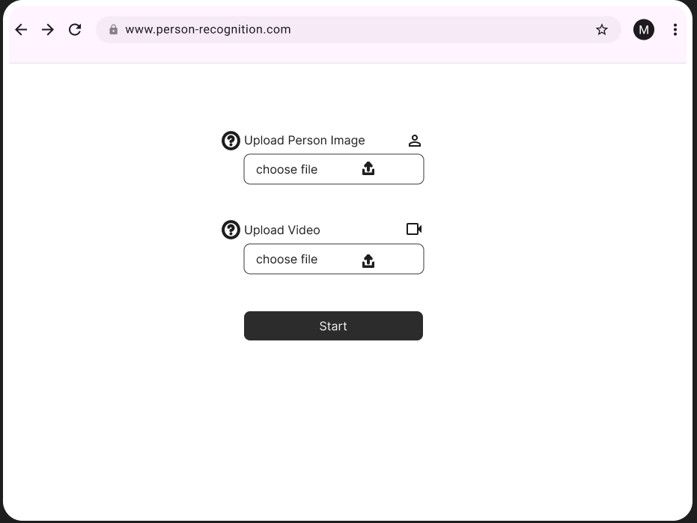




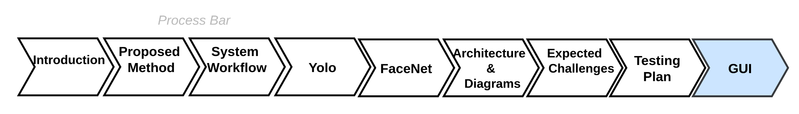
User Interface
17

Slide 20


User Interface
Analyzing..
18

Slide 21
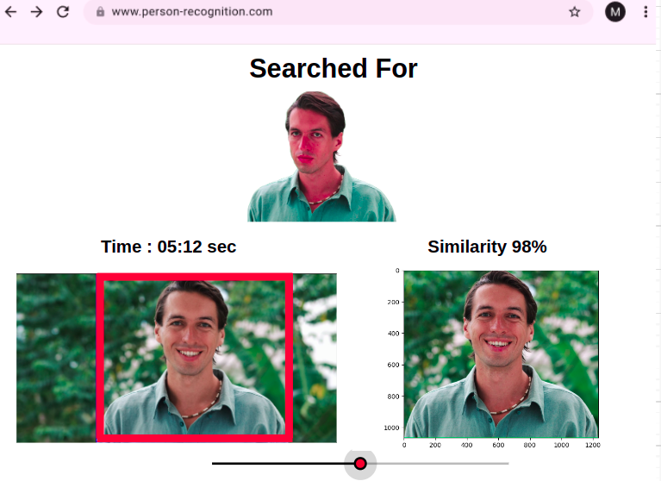
User Interface
19

Slide 22
THANK YOU!
20

